Slide 1


SLOW CLOTHES
The opposite of Fast Fashion

Slide 2


Fits on Fire…
Fashion Industry accounts for 8-10% of global carbon emissions
70 million barrels of oil a year to make polyester fibers
A pair of Levi jeans creates emissions equivalent to driving 69 miles in the average US car
34% from fabric manufacturing, 8 % from sewing, 16% from transport, and 40% from consumer washing/use and disposal in landfill
20% of wastewater – manufacturing single pair of jeans uses up 1 kilogram of cotton, requiring 7,5000 to 10,000 liters of water
10 years' worth of drinking water for 1 person

Slide 3
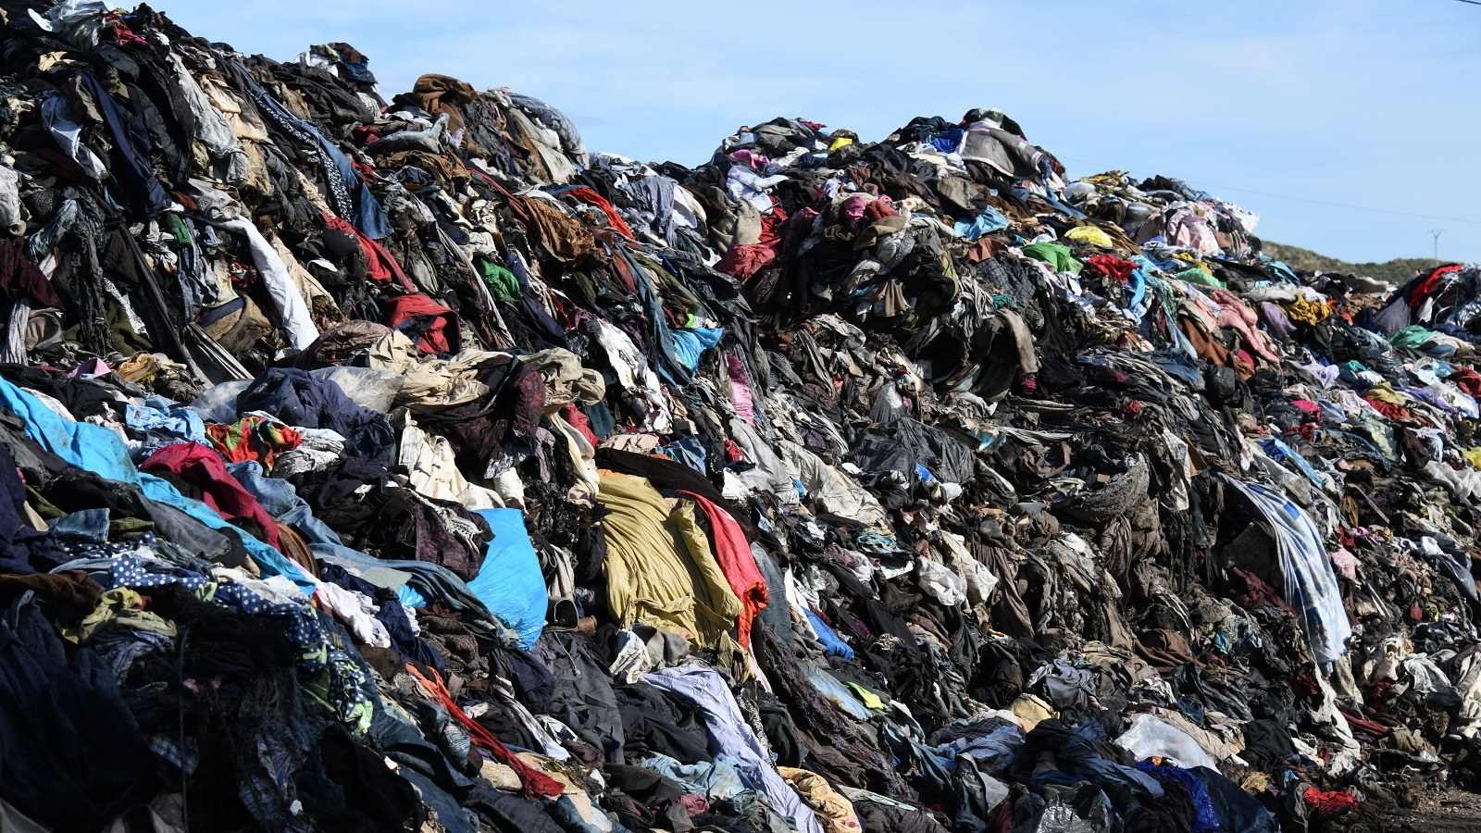
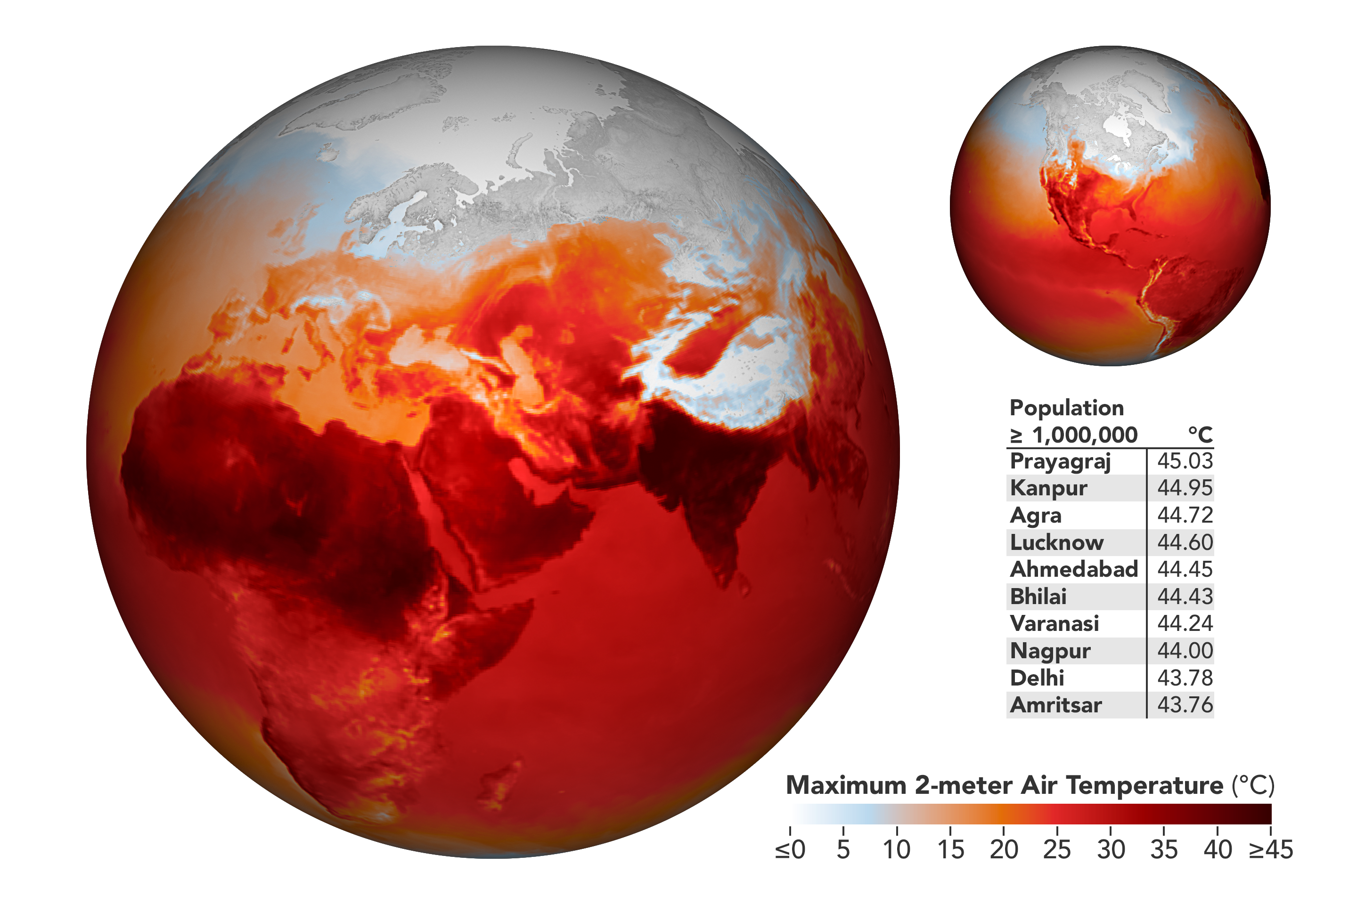

…Creating a world on fire

Slide 4





How this project came about…
- Moving to Canada, so in the process of packing up, decided to donate clothes that I realized I don’t wear anymore (I’m a part of the problem!)
-during the same time as Tax Deadline, where I wanted to figure out how to milk the IRS for highest possible return

Slide 5
…So decided to create Slow Clothes.
The opposite of Fast Fashion

Slide 6
Use Case
Encourage donating clothes instead of throwing them out to landfill
Finds the closest clothes donation location from a user’s location and where to donate
Records what is being donated, with an estimated dollar amount based on the Salvation Army average donation values. Find’s the total sum and then record that donation log. Eventually have year’s total donation valuation.
Donations valued at $300 or more in a year can be recorded as a tax deduction in that year’s tax return, giving more $ back to the user
Encourage donating clothes over waste to landfill, and hopefully improves donation quality at thrift shops and shelters.
Does it encourage less shopping? – will it eventually lead to buy it for life mentality and the app’s practically diminish?

Slide 7
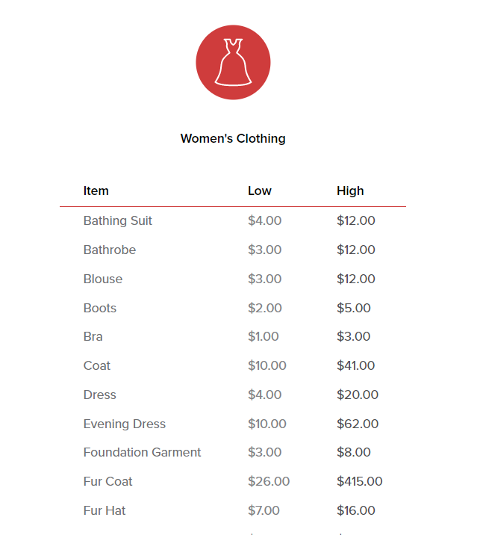
DEMO….
Salvation Army Valuations example

Slide 8
Next Steps
Add a total Sum Button for the valuations at the end.
Prettify it up – make it look professional! Like someone wants to use it. That’s how you add in the annoying ads to starting making $$$
Add directions feature from location to donation site, and change up the markers
Store each donation in a log to find the yearly amount
Link this app with the donation site, so they can sign off on the donation. This makes it legitimate for the IRS. Provides the donation site a way to accept or reject items in good condition or not.

Slide 9
Sources
Mjumbe Poe – shout out for helping this JavaScript figure it out
https://satruck.org/Home/DonationValueGuide
https://data.cityofnewyork.us/Environment/Textile-Drop-Off-Locations-in-NYC/qnjm-wvu5
https://www.bbc.com/future/article/20200310-sustainable-fashion-how-to-buy-clothes-good-for-the-climate
Sustainable Cities Spring Semester Class
https://www.bankrate.com/taxes/donation-value-guide/

